Slide 1
Scaffold-based analytics: minimal user interface
Deepak Bandyopadhyay

Slide 2
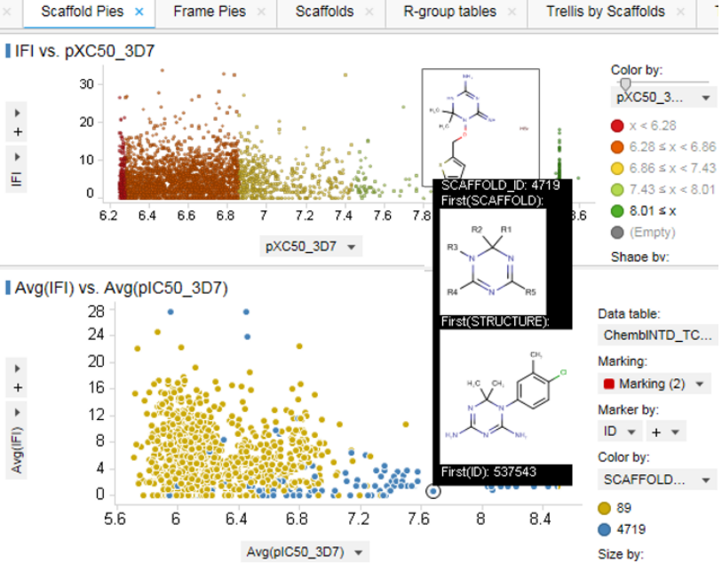
Spotfire user interface 1 – scaffold pies
Related Molecules page, with molecule selection in the top panel and related molecules viewed as one pie sector per scaffold shared

Slide 3
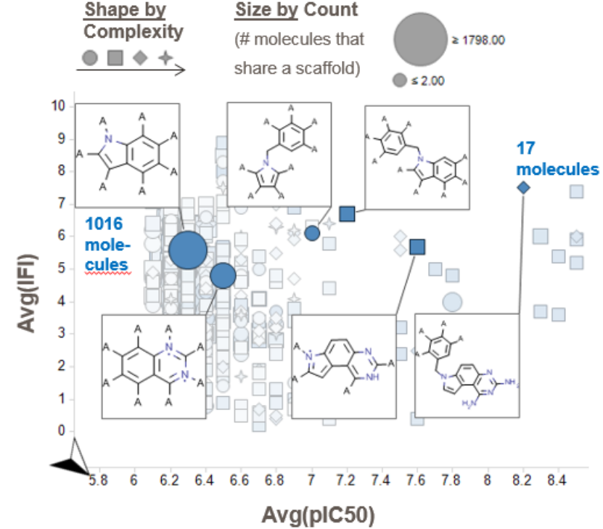
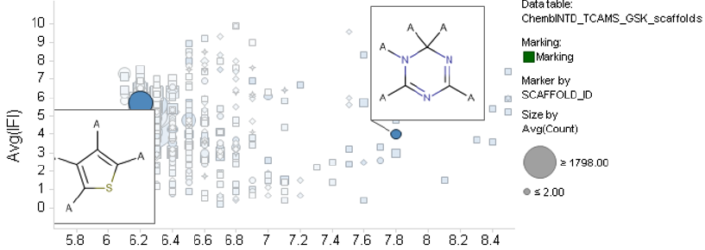
Spotfire user interface 2 – aggregate scaffolds
Aggregate plot of scaffold statistics (often appearing alongside a detailed drill-down into the selected scaffold)

Slide 4
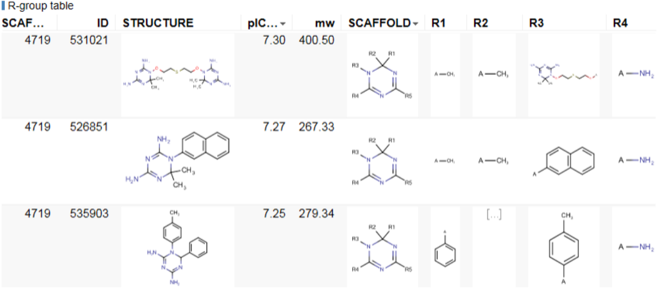
Spotfire user interface 3 – R-group table for selected scaffolds

